Slide 1






PowerShell Conference Asia
SQL Server Reporting services
New best friend - PowerShell

Slide 2










Who am I?
Cláudio Silva
MS SQL Server
DBA | Data architect
Working with MS SQL Server since version 2000
PowerShell MVP
Work with community
1st major contributor on dbatools (http://dbatools.io) open source project
Contributions to ReportingServicesTools module
PASS Portuguese VG Co-lead
Creator of @psmcentral repository
Friend of redgate
PowerShell Conference
Singapore 2017
@claudioessilva
claudioessilva
claudioessilva.eu

Slide 3
Agenda
What is and where I can find ReportingServicesTools?
How does it work?
System Requirements
Installation
What is included?
Demos!
PowerShell Conference
Singapore 2017

Slide 4
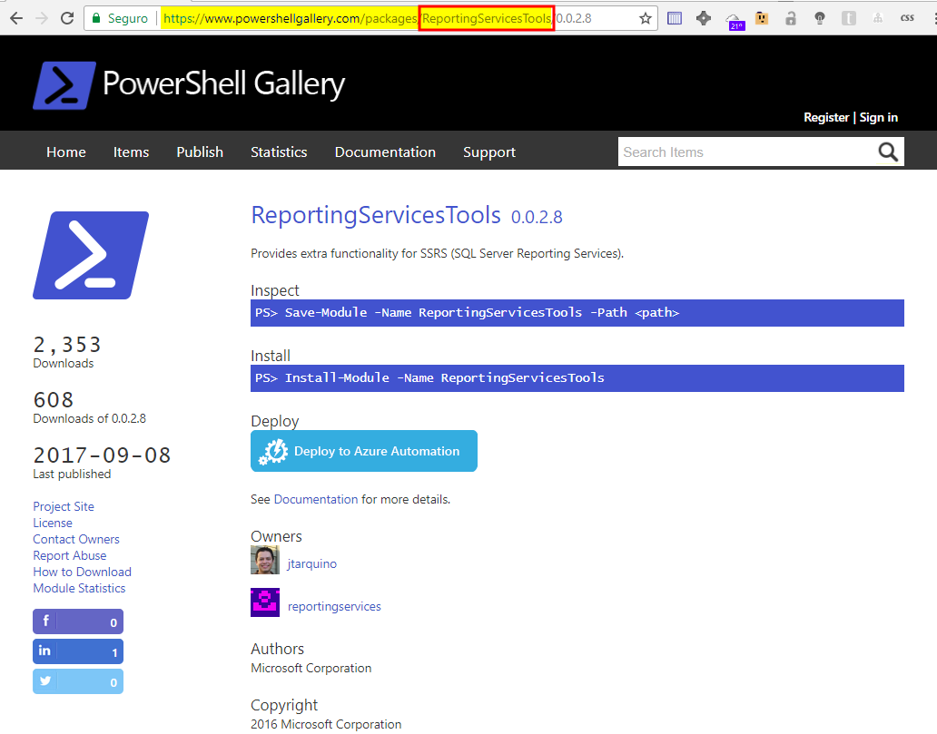
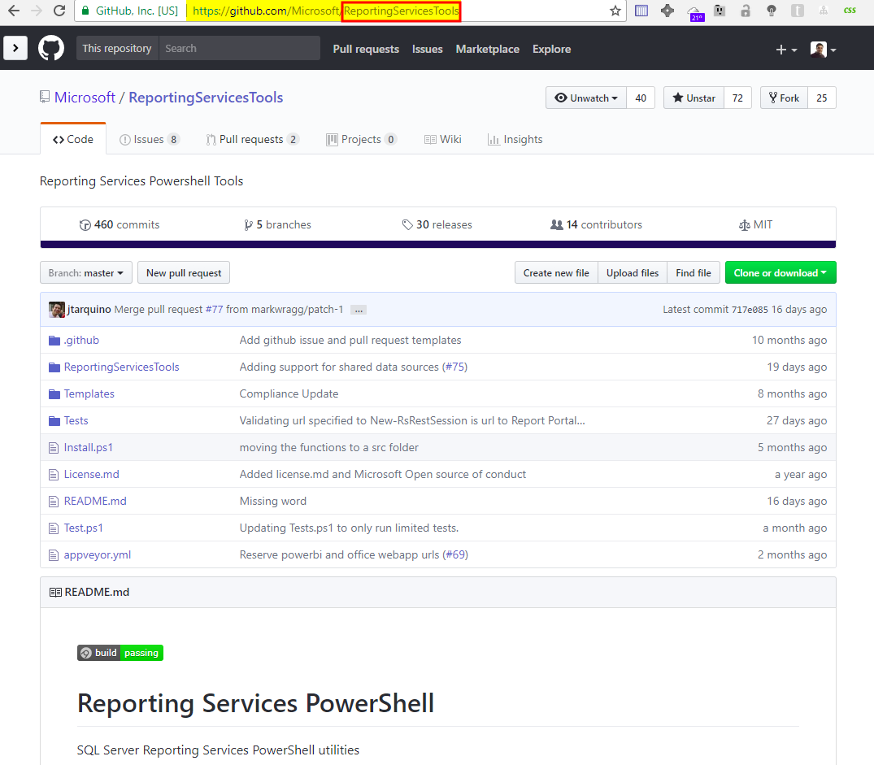
What is and where I can find ReportingServicesTools?
Open Source PowerShell Module
Allow us to perform operation with SQL Server Reporting Services
Available on
Contributors
14
Downloads
2355
GitHub
PowerShell Gallery
PowerShell Conference
Singapore 2017

Slide 5
How does it works?
Two different APIs
SOAP
WMI
Reporting Services
&
Web Portal
Reporting Services
Configuration Manager
Examples:
Reports
Subscriptions
Examples:
Backup Encryption Key
Set Email Settings
PowerShell Conference
Singapore 2017
Notes:
Both are documented and you can find more details about SOAP (Simple Object Access Protocol) API at https://msdn.microsoft.com/en-us/library/ms154052.aspx and the WMI (Windows Management Instrumentation) API at https://msdn.microsoft.com/en-us/library/ms152836.aspx.
Some limitations on the WMI side. Always test it on non-production environments.

Slide 6
System requirements
Minimum
Client
PowerShell v3+
Server
SQL Server Reporting Services 2008 R2 +
Note: If you want to contribute with features/bug fixes the minimum version should be v4.0 because Pester testing framework
PowerShell Conference
Singapore 2017

Slide 7
Installation
PowerShell Gallery
Install-Module –Name ReportingServicesTools
Install-Module –Name ReportingServicesTools –Scope CurrentUser
GitHub
Invoke-Expression (Invoke-WebRequest https://aka.ms/rstools)
PowerShell Conference
Singapore 2017
Github: https://github.com/Microsoft/ReportingServicesTools

Slide 8
What is included?
30+ Commands
Catalog items:
Folders
Data sources
Reports
Subscriptions
Security:
Grant/Revoke Permissions
Configuration Manager options:
Encryption Keys
Email settings
URLs settings
Utilities:
Connect to Report Server
Proxy
PowerShell Conference
Singapore 2017
Notes:
Talk about GitHub repository. Remember that people can contribute with ideas, code or just report bugs

Slide 9
DEMOS!
PowerShell Conference
Singapore 2017
More: about_Comment_Based_Help
Notes:
One of the most important and useful cmdlets to work with PowerShell ☺

Slide 10
Don’t Forget!
Fill in your survey in Mobile app – it’s how we do better!
Don’t lose you badge! You need it for the Social Events
Grab the Speakers for a chat – they all have time for you!
Let everyone know what they are missing on Social Media
#PowerShell
#PSConfAsia
Photos of Marina Bay Credit: Sebastian Szumigalski
PowerShell Conference
Singapore 2017

